Slide 1
Home
About Us #
Infrastructure
Academic #
Gallery
Admission #
Online Admission #
Contact Us
Help Us
Registration
Username is available.
Student Name
User Name
Sachin2593: Username not available.
Email
Get OTP for Email ID Verification
Mobile No
Get OTP for Mobile Verification
Date Of Birth
Password
Confirm Password
Verification Image
6577473
Enter text image
Create User
Reset

Slide 2

Logo
KMS English Medium School (CBSE)
Home
About Us #
Infrastructure
Academic #
Gallery
Admission #
Online Admission #
Contact Us
Help Us
Login Here
User name
Password
Keep me Signed in
Login
Forgot Password / Username ?

Slide 3
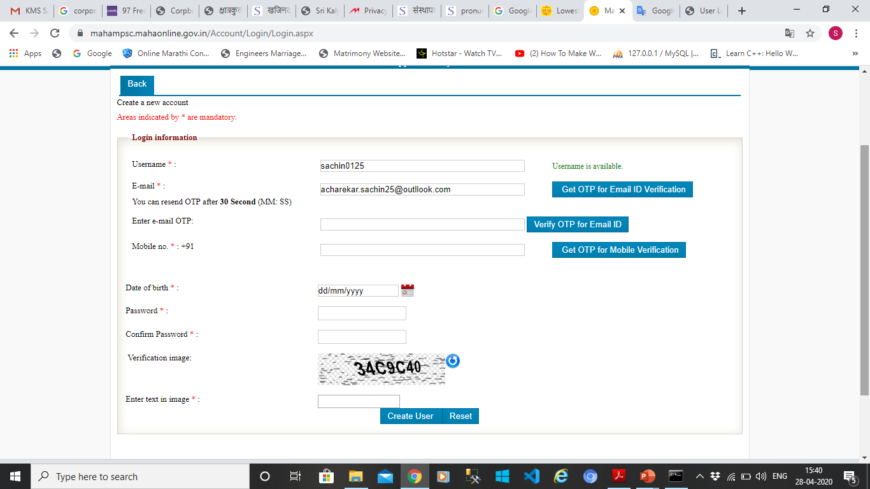

Slide 4
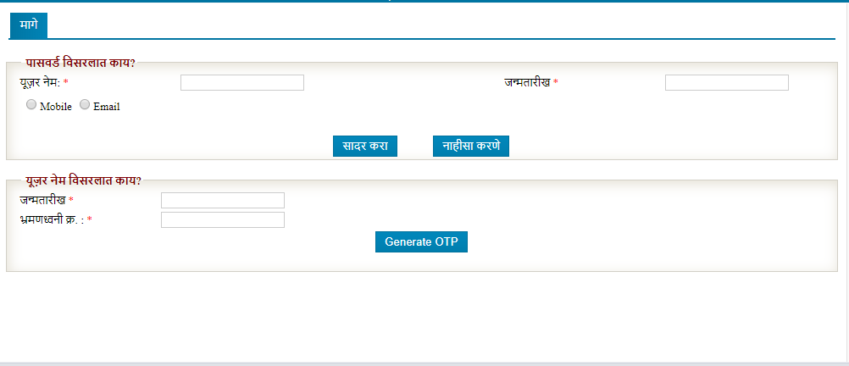

Slide 5
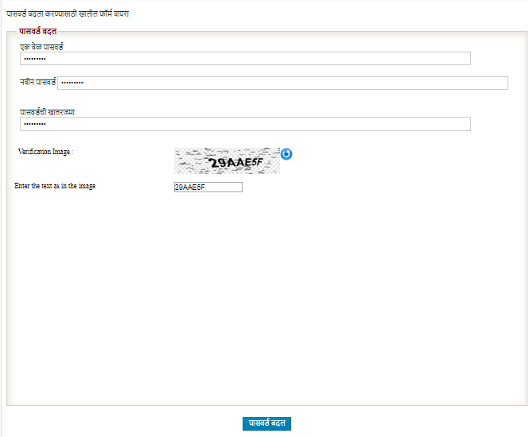

Slide 6
KMS English Medium School (CBSE)
Main Page
Profile Creation
Your Account
Help
Log Out
Steps of Application Submission
Latest News
Application Submission Process
There are FOUR stages of application submission.
1. Profile Creation/Updation
2. Upload Photo / Document as per required
3. Admission Fees
4. --------------------------------------
Detail Steps
1. If you are new user, create user name and password for log in into CBSE Website.
2. After log in into this website, enter your complete profile. Keep ready Scanned copy of your photo / Signature / Document as per required. (any Size upload )
a) (Student / Father / Mother) both Phots are Compulsory Upload
3. Admission Process Fees Rs. 1000/- all standard and pending fees your Accept form after paid the payment
4. Please filled the all details are compulsary)

Slide 7
4. Document required as per below
Document :
1. Birth Certificate
2. School living Certificate
3. Student Aadhar Card
4. Cast Certificate
5. Mark list of Previous std
6. Parent ID (PAN Card / Aadhar Card)
Any one

Slide 8
Profile Creation
My Account
Help
Help
Profile Creation
Log Out
Main Page
Your Account
Step 1:
Student Information
Step 2:
Parent's Details
Step 1:
Details of Local Guardian :
Step 1:
Upload Photo/Signature/Document
Student Information
Name of the Student :
Surname
First Name
Middle Name
Class in which admission sought :
Sex :
Male
Female
Date of Birth :
Date
Month
Year
Age :
Year
Place of Birth :
Blood Group :
Select
Nationality :
Select
Religion :
Select
Mother Tongue :
Category :
Select
Student Aadhar No.:
Minority :
Select
Only Child :
Select

Slide 9
If No, Brother / Sister studying in this School :
Name :
1 )
Class :
Sec :
2 )
Class :
Sec :
3 )
Class :
Sec :
Playgroup / Nursery Previously attended :
Availing School Transportation (Yes / No) :
Select
Area :
Full Residential Address :
Address
Address 1
Address 2
Landmark
Country
Select
State
Select
District
Select
City
Select
Pin-code
Sumbit
Reset

Slide 10
Are you sure you want to save personal details?
Sample.com says
Sample.com says
Student Information Save Successfully
Ok
Cancel
Ok

Slide 11
Main Page
Profile Creation
Your Account
Help
Log Out
Step 1:
Student Information
Step 2:
Parent's Details
Step 1:
Details of Local Guardian :
Step 1:
Upload Photo/Signature/Document
Step 1:
Payment
Father
Mother
Full Name
Full Name
Qualification :
Qualification :
Occupation (Sevice / Business) :
Occupation (Sevice / Business) :
Annual Income :
Annual Income :
Office Address :
Office Address :
Mobile No :
Mobile No :
Email ID :
Email ID :

Slide 12
Full Residential Address :
Address
Address 1
Address 2
Landmark
Country
Select
State
Select
District
Select
City
Select
Pin-code
Sumbit
Reset

Slide 13
Step 1:
Student Information
Step 2:
Parent's Details
Step 1:
Details of Local Guardian :
Step 1:
Upload Photo/Signature/Document
Step 1:
Payment
Details of Local Guardian :
Name
Address
Address 1
Address 2
Landmark
Country
Select
State
Select
District
Select
City
Select
Pin-code
Mobile No
Sumbit
Reset

Slide 14
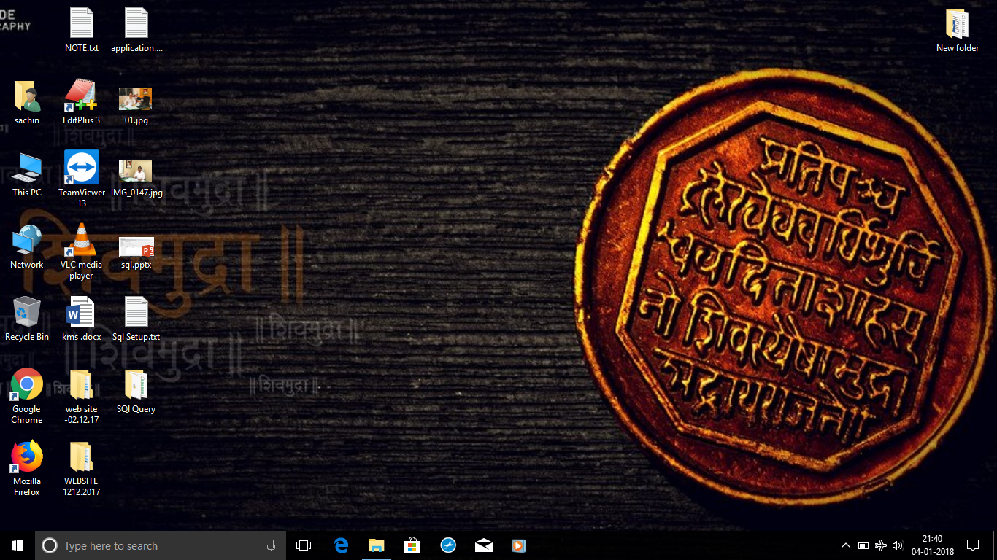
Step 1:
Student Information
Step 2:
Parent's Details
Step 1:
Details of Local Guardian :
Step 1:
Upload Photo/Signature/Document
Step 1:
Payment
Photo & Signature
Student Photo
Father Photo
Mother Photo
Choose File
Choose File
No file Chosen
Choose File
No file Chosen
No file Chosen
Upload Document
No file Chosen
Choose File
Signature of Father / Mother / Guardian
Document.pdf
No file Chosen
Choose File
Document.jpg
Document.png
Sumbit
Reset

Slide 15
KMS English Medium School (CBSE)
Main Page
Help
Your Profile
View Profile
Photo
Full name :
Sachin Prakash Acharekar
Class :
Senior KG
Update Profile
Admission No :
12345678
Print Profile
Mobile No :
1234567890
Latest Notification
Change Password

